Slide 1
Capstone Project – 2
TED Talk Views Prediction
By:
Aehteshaam Shaikh

Slide 2
Problem Statement :
The TED dataset contains information about all audio-video recordings of TED Talks uploaded to the official TED.com website until the Year 2020.
It contains information about all talks including number of views, number of comments, descriptions, speakers,titles, transcripts, etc.
The main objective is to build a Predictive Model which could help in predicting the views of the videos uploaded on the TEDx website.

Slide 3
Data Summary:
Sr | Column Name | Description
1 | talk_id | Talk identification number provided by TED
2 | title | Title of the talk
3 | speaker_1 | First speaker in TED's speaker list
4 | all_speakers | Speakers in the talk
5 | occupations | Occupations of the speakers
6 | about_speakers | Blurb about each speaker
7 | recorded_date | Date the talk was recorded

Slide 4
Data Summary:
Sr | Column Name | Description
8 | published_date | Date the talk was published to TED.com
9 | event | Event or medium in which the talk was given
10 | native_lang | Language the talk was given in
11 | available_lang | All available languages (lang_code) for a talk
12 | comments | Count of comments
13 | duration | Duration in seconds
14 | topics | Related tags or topics for the talk

Slide 5
Data Summary:
Sr | Column Name | Description
15 | related_talks | Related talks (key='talk_id', value='title')
16 | url | URL of the talk
17 | description | Description of the talk
18 | transcript | Full transcript of the talk
19 | views | Count of views (Target Variable)

Slide 6
Data Cleaning:
The data set consist of around 4005 rows and 19 columns.
Following columns consisted of Null values:
1. all_speakers
2. occupations
3. about_speakers
4. recorded_date
5. Comments
The Null values in the occupations, comments, recorded date, all_speakers were replaced with suitale values.
The column about_speakers has been dropped.

Slide 7
Exploratory Data Analysis

Slide 8
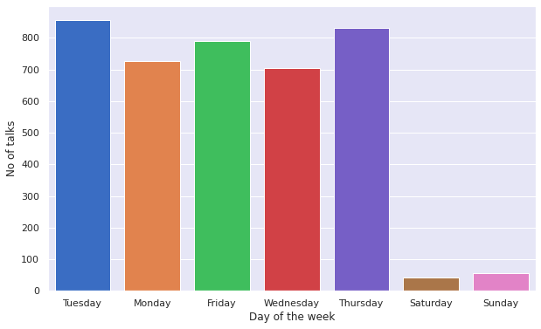
Most no of talks were released on Tuesday followed by Thursday. As we can see on saturday and sunday very less ted talk videos were published

Slide 9
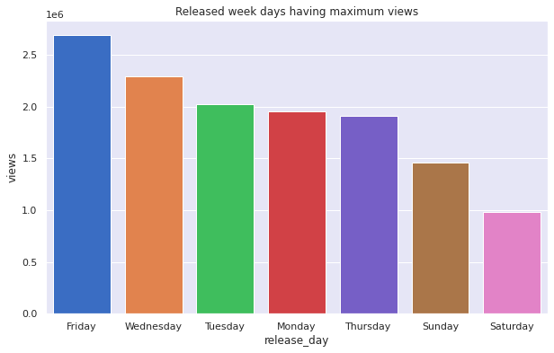
Most no of views are for the videos which are released on Friday.

Slide 10
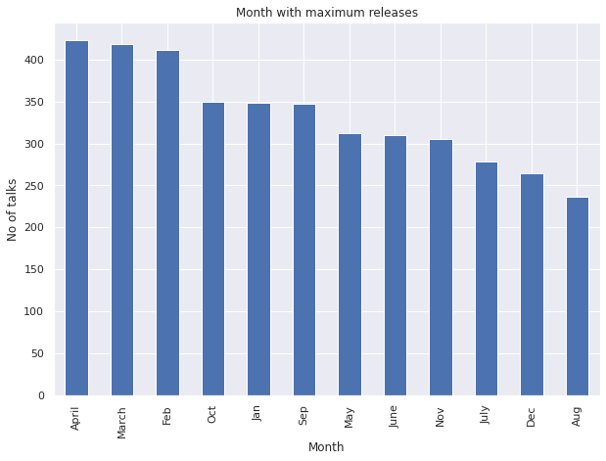
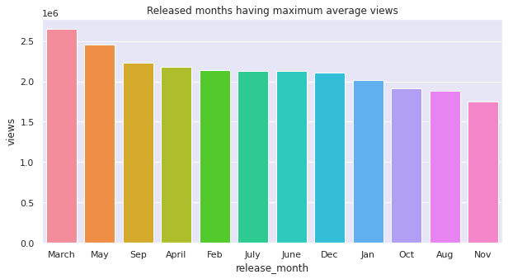
Most no of talks were released in April Talks released in March have most followed by March and Feb. views followed by May.

Slide 11
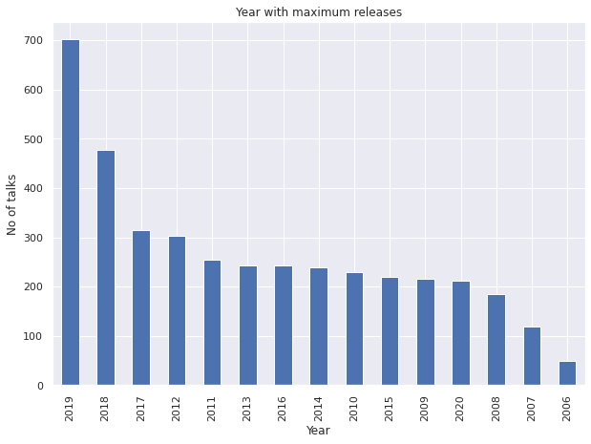
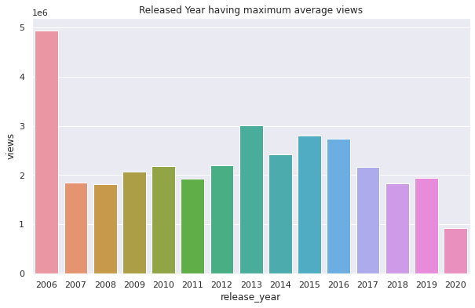
Most no of Talks were released in year 2019 but Talks released in the year 2006 have the maximum average views.

Slide 12
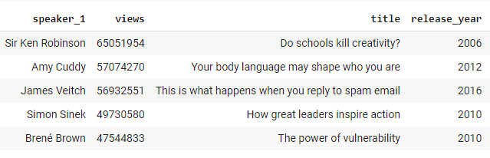
Sir Ken Robinson's 'Do schools kill creativity?' is the most viewed Talk with more than 65 million views.

Slide 13
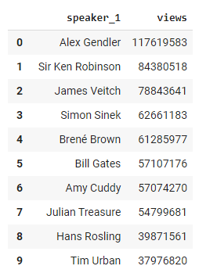
Alex Gendler is the most Popular speaker followed by Sir Ken Robinson

Slide 14
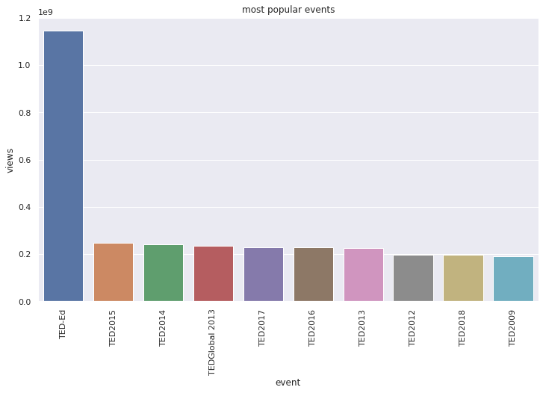
TED-Ed is the most popular event category with most no of views

Slide 15
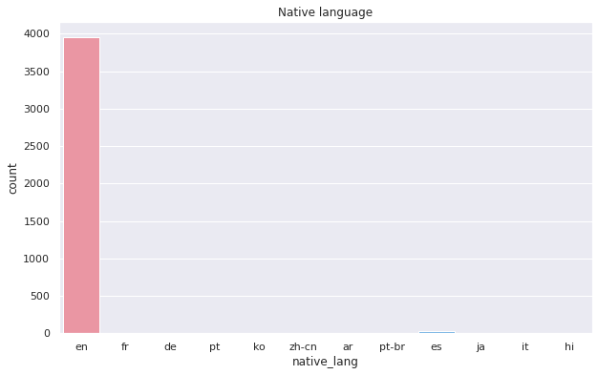
Almost 99% videos are recorded in English language

Slide 16
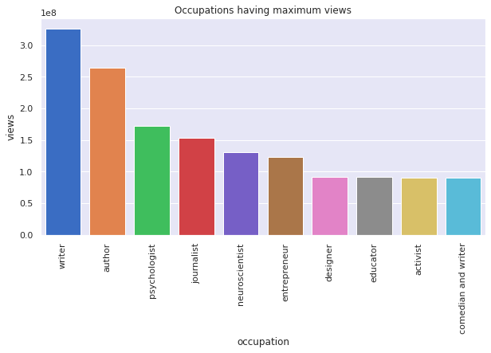
Speakers who are Writers are most popular followed by Authors and Psychologists.

Slide 17
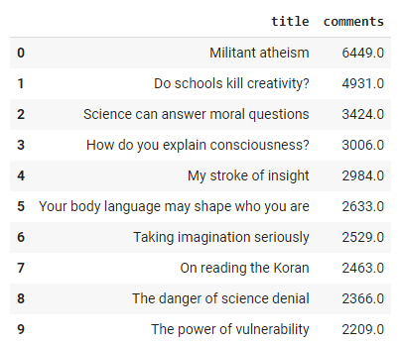
It seems that most of the debated topics are related to mainly Science and Religion

Slide 18
Feature Engineering :
The following Categorical Features are replaced by doing Mean Encoding.
speaker_1 avg_views_by_speaker
event avg_views_by_event
The following Categorical Features are replaced by numerical features.
available_lang total_lang
topics no_of_topics
added a new column called video_age which is the difference of current year and published year.

Slide 19
Feature Engineering :
Following columns consisted Outliers:
1. avg_views_by_event
2. avg_views_by_speaker
3. comments
4. duration
5. no_of_topics
6. total_lang
7. views
The outliers are replaced with the Extreme values.

Slide 20
Feature Engineering :
One Hot Encoding is performed on the following categorical Features:
1. release_day
2. release_month

Slide 21
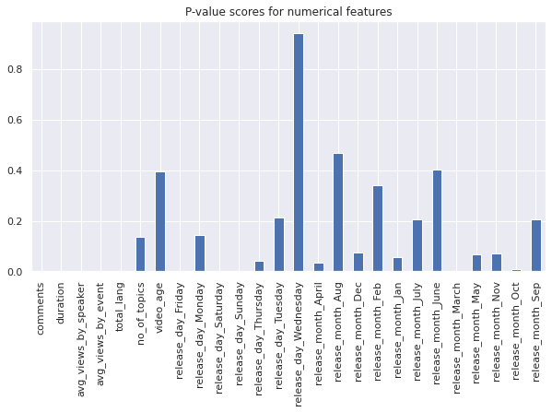
Feature Selection:
Using f-scores, the features with high p-values have been dropped to get the final list of dependent variables.

Slide 22

Machine Learning

Slide 23
ML Models Used : 1. Linear Regression 2. Random Forest Regressor 3. XGBoost Regressor Model Tuning methods used: 1. Ridge Regression 2. Lasso Regression 3. Elastic Net Regression Hyper-Parameter Tuning metods used: 1. GridSearch CV 2. RandomSearch CV

Slide 24
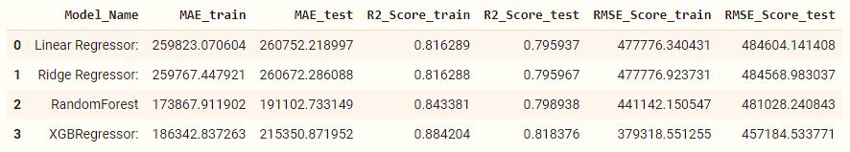
Results obtained after Training the Dataset : 1. In terms of RMSE and R-squared, XGBoost is the best performer 2. In terms of Mean Absolute Error, Random Forest Regressor is the best performer .

Slide 25
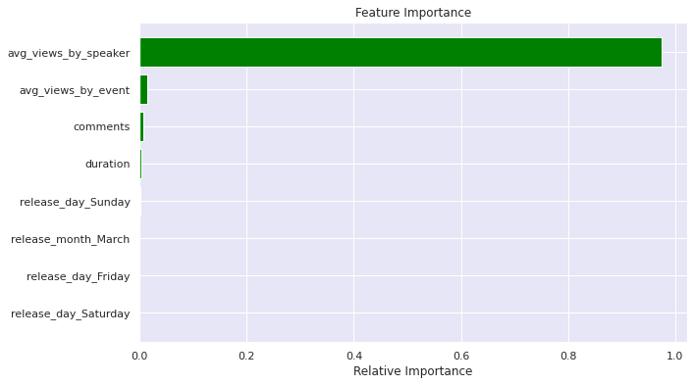
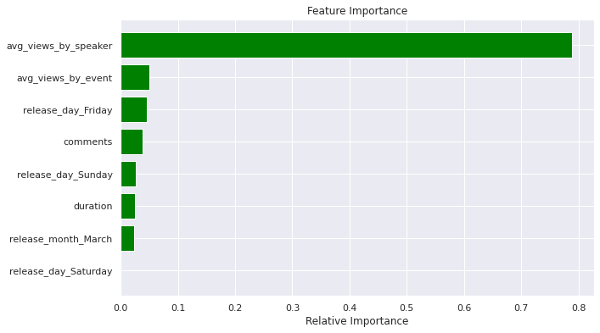
Feature Importance:
In all of the models, it has been observed that the column avg views by speaker is the most important feature in the dataset followed by avg views by event.
Random Forest Regressor
XGBoost Regressor

Slide 26
Conclusion:
After loading the dataset, cleaning the data, performing EDA, Feature Engineering and after feature selection, Models are built.
In all of the models, it has been observed that the column avg views by speaker is the most important feature.
In terms of RMSE score XGBoost Regressor gave the best results. As, to compare the Accuracy among different regression models, RMSE is a better option as it is simple to calculate and differentiable. However, our dataset had outliers, hence MAE is better metric than RMSE as it is robust to outliers.
So, after comparing MAE values it is evident that Random Forest Regressor is the best performer.
that the column avg views by sp

Slide 27

PRESENTATION

